Slide 1



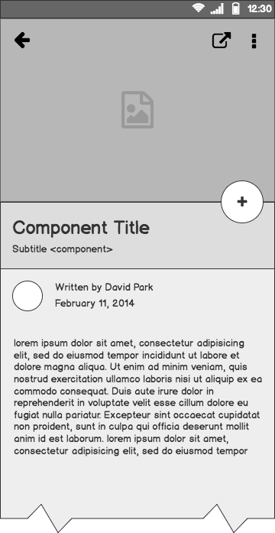
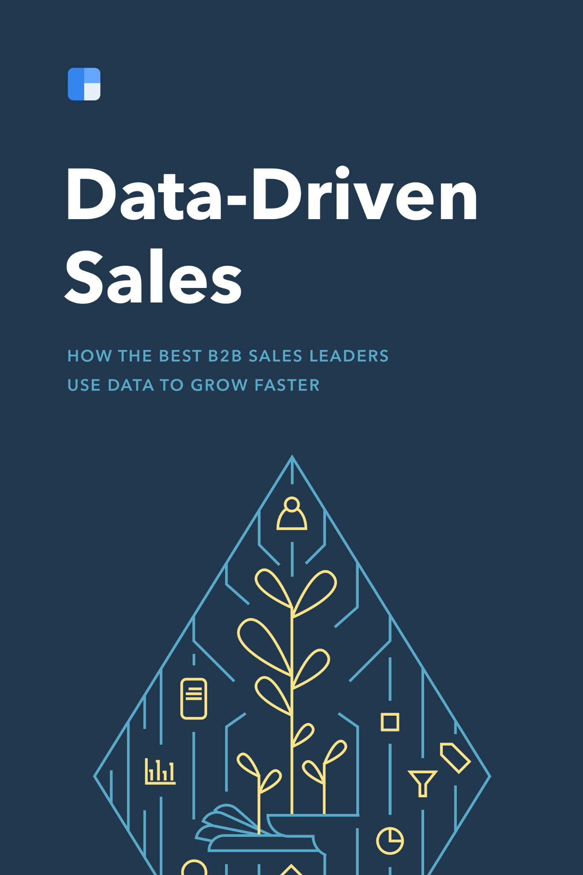
Data Management Project
Project on IKEA Furniture Retails Sales Data Analysis on Various Business Problem, Solution proposal & Results.

Slide 2
Outline
The Problem
Solution Proposal
Project Stage I,II,III
Results
Visualizations
Dashboards
Conclusion

Slide 3
The Problem

Slide 4
Problem statement
Decreasing in Sales of IKEA furniture in FY (2015-16) due lack to understanding and giving importance to data..
Not understanding the market properly and lacking data driven decision which made sales decreasing.
Business Evolving growth remains limited due to Stangant resources and unavailibility of data.
For any Business Growth Rate is very important and here it’s a serious issue, due to absence of data, insights can’t not be drawn properly.

Slide 5
What customers do today
Does sales mostly depends on online or offlines, Why most of customer’s data is most important in today’s time?
Basically it depends, in 2015-16, Internet wasn’t evolved as much in recently 2020-21. At time one have to reach the store to buy something with hassal but now store reach to customer without hassal, in cost of some data. That particular data help the store to grow immensly as those data provided insights to the Company which help them to take Business Driven Decision. This particular wasn’t available to the store of that time, if available then there wasn’t person related to Data to help them out.

Slide 6
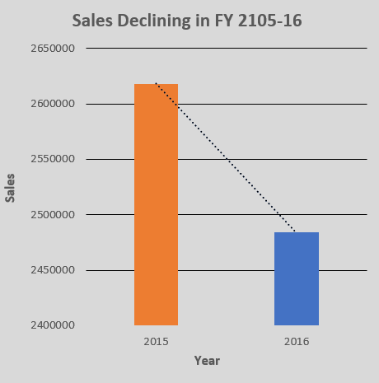
Supporting information
01
1
Business unable to follow rapidly changing trends mostly lead to declining in sales.
Due to the absence of Proper Data’s Managing and Storing, Company was unable to take Data Centric Decisions.

Slide 7
Supporting information
02
82%
Users are constantly searching for a solution
Due to the Evolving nature of Data, User’s constantly update themselve with the World almost every single moment.
Customer’s data becomes so integral for a business to thrive in huge competition,collecting data has become a norm.

Slide 8
Timeline
Data Gathering
Built an Excel Table
ETL on Database
Generate Complex Insights
Generating Sales Insights
Desing Dashiboard & Analysis
Display the Required Insights

Slide 9
Tools and Methodologies used :
Data Validation, Data Cleaning, Data Profiling, Data Integration, Data Mapping, these are one the First Methodologies used.
Second Methodologies include Data import from Excel to SQL Server Database, using ETL process & Data are futher Cleaned and Validated by using SQL Queries.
Finally Data Visualization is done by using Excel through Various Charts, Dashboard & Mainly Story Telling through Data.
Stake Holder’s, Client’s & Business Partner’s are provided summary of data in order to take Business Proposal’s..
Note: Tools used MS SQL Server & EXCEL. And in this Process is mostly driven by Data Related Person

Slide 10
About IKEA Furniture Retails :
IKEA Furniture is Furniture industry, like all other the companies and activities involved in the design, manufacture, distribution, and sale of functional and decorative objects of Household,Office & Technical equipment.
The customer generally used to visit IKEA stores in FY2015-16,offline and the Payment was received Cash and Card mode only, and The product was delivered to customer in Standard Class with less cost but with more hassle, Premium Delivery Process were costly mostly can’t afford it. Outlets were present only in Business Oriented cities,limited resource were present to deal Data Driven Solution which was not possible

Slide 11
Solution Proposal
FY 2017-18, IKEA hired a Data Management Team, to collect and store data of customer from Different Outlets in order to draw some Meaningful & Useful Insights to help the Company’s Growth and Increase in Revenue.
Stakeholder/ Clients/Directors want to take some Data Driven Decisions like :
Should Online Payments be accepted watching at the current trend ?
Should the Product Delivery Speed be enhanced with cost-effectiveness ?
Opening of an Online Store, would be beneficiary ?
And most importantly, how to increase overall revenue of the company ?

Slide 12
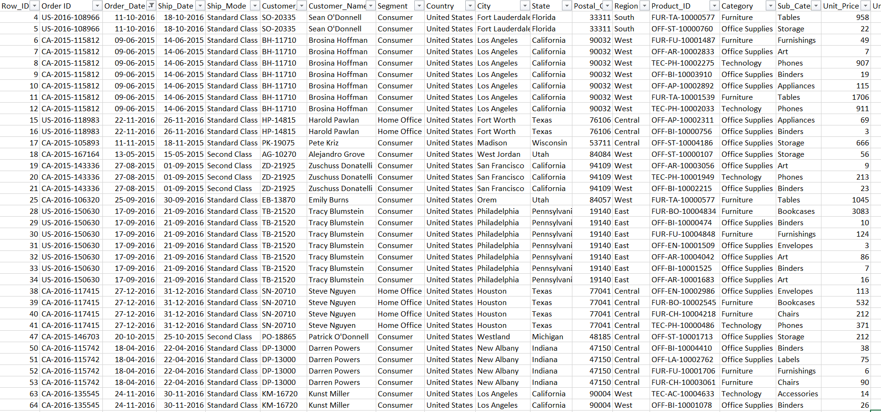
Project Stage I
Data are collected from the FY 2015-16, and Descriptive Analysis is runned through it extensively to find out the Reason behind.
Figure 1 : Datasets of FY 2015-16

Slide 13
Resulting Solutions of Stage 1:
After running Descriptive Analysis on the Historical Data of FY 2015-16,
Analyst discovered loopholes in Data Sets, started Procuring to anticipate Stakeholders/Director/Client’s Decisions.
Figure 2 : Insights for the loss Occurred in FY 2015-16

Slide 14
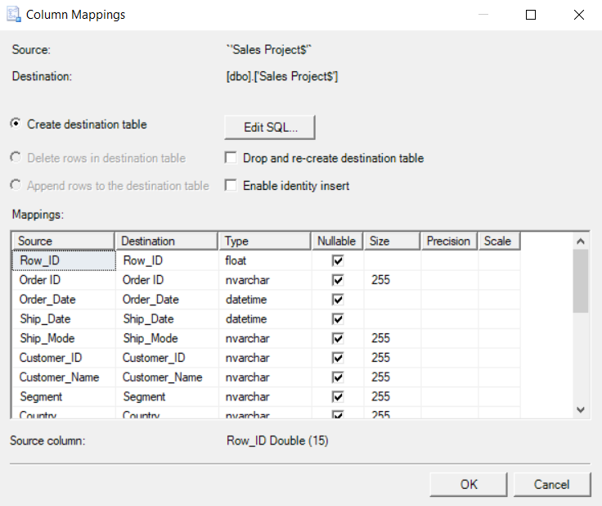
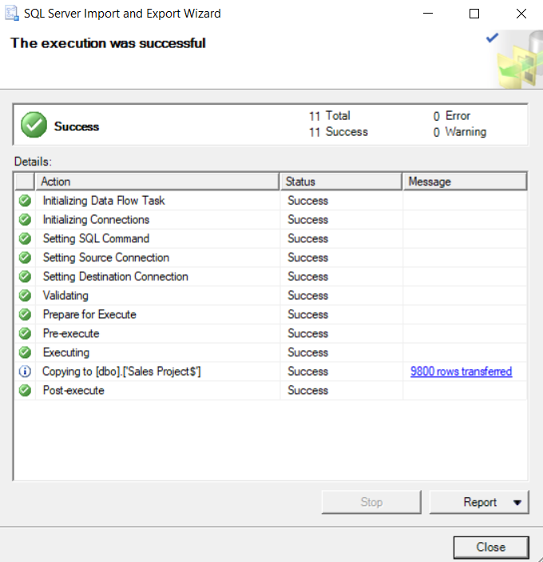
Project Stage II
Data Transformation and Loading into Database :
For the data transformation and loading Microsoft SQL server management studio is used. The data is first extracted from excel sheets and then loaded into database. Then the data gets loaded into the mentioned destination
Figure 3 : Transformation of the Data
Figure 4 : Successfully loaded into destination

Slide 15
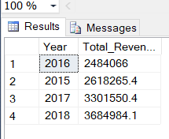
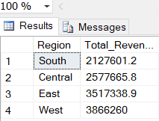
Project Stage III
Performing SQL Queries on the Loaded Data:
--(1)-Query for calculating Total Revenue generated Year wise ?
Select Year(order_date) as Year, round(sum(total_sales),2) as Total_Revenue from SalesProject
Group by Year(Order_Date)
Order by Sum(total_sales);
--(2)-Query for calculating the most amount of Revenues generated by which region ?
Select Region,Round(sum(total_sales),2) as Total_Revenue from Salesproject
Group by region
Order by Total_Revenue;

Slide 16
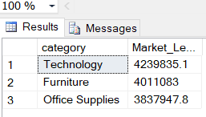
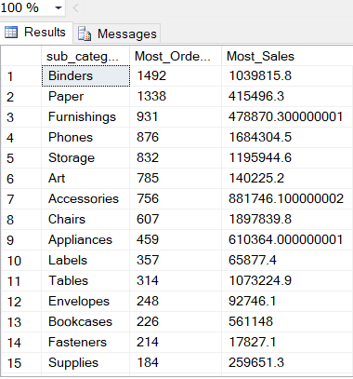
Performing SQL Queries on the Loaded Data:
--(3)-Query for checking the Major Category Product leading the market all time ?
select distinct(category),Round(sum(total_sales),2) as Market_Lead
from SalesProject
group by Category
order by Market_Lead desc;
--(4)-Query for calculating the most order and most sales sub-categories ?
select distinct(sub_category), count(units) as Most_Ordered, sum(total_sales) as Most_Sales from SalesProject
group by Sub_Category
order by count(units) desc, sum(total_sales) desc;

Slide 17
Results :
Year 2018, after the Inclusion of Data Analyst not only just increased in Sales Revenue for IKEA company but it increased Overall Growth in terms of:
Successfully analysing the trends over the period of time
Successfully increasing the resource by limiting and expanding the production
Regions wise reach increased due to Online Store available in various areas.
Delivery facilities seamlessly increased to minimal cost due to increase in sales
Accepting Payment in all forms of way available

Slide 18
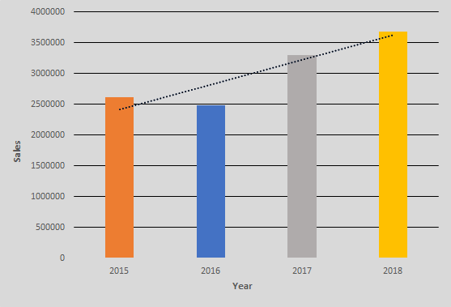
Visualizations :
Inclusion of Data Analyst, helped the Sales to grow exponentially

Slide 19
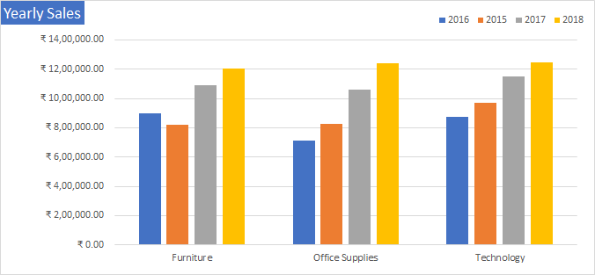
Visualizations :
Meeting the needs, showing the yearly sales increment in Category section, after the downfall of FY 2015-16

Slide 20
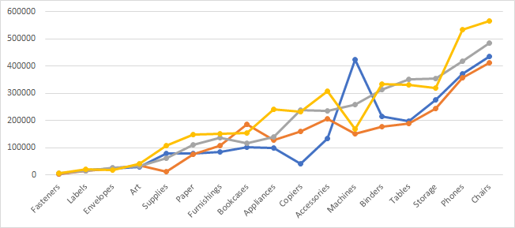
Visualizations :
Supply meet demands, intensive research made them analyze the trend of particular sub-categories.

Slide 21
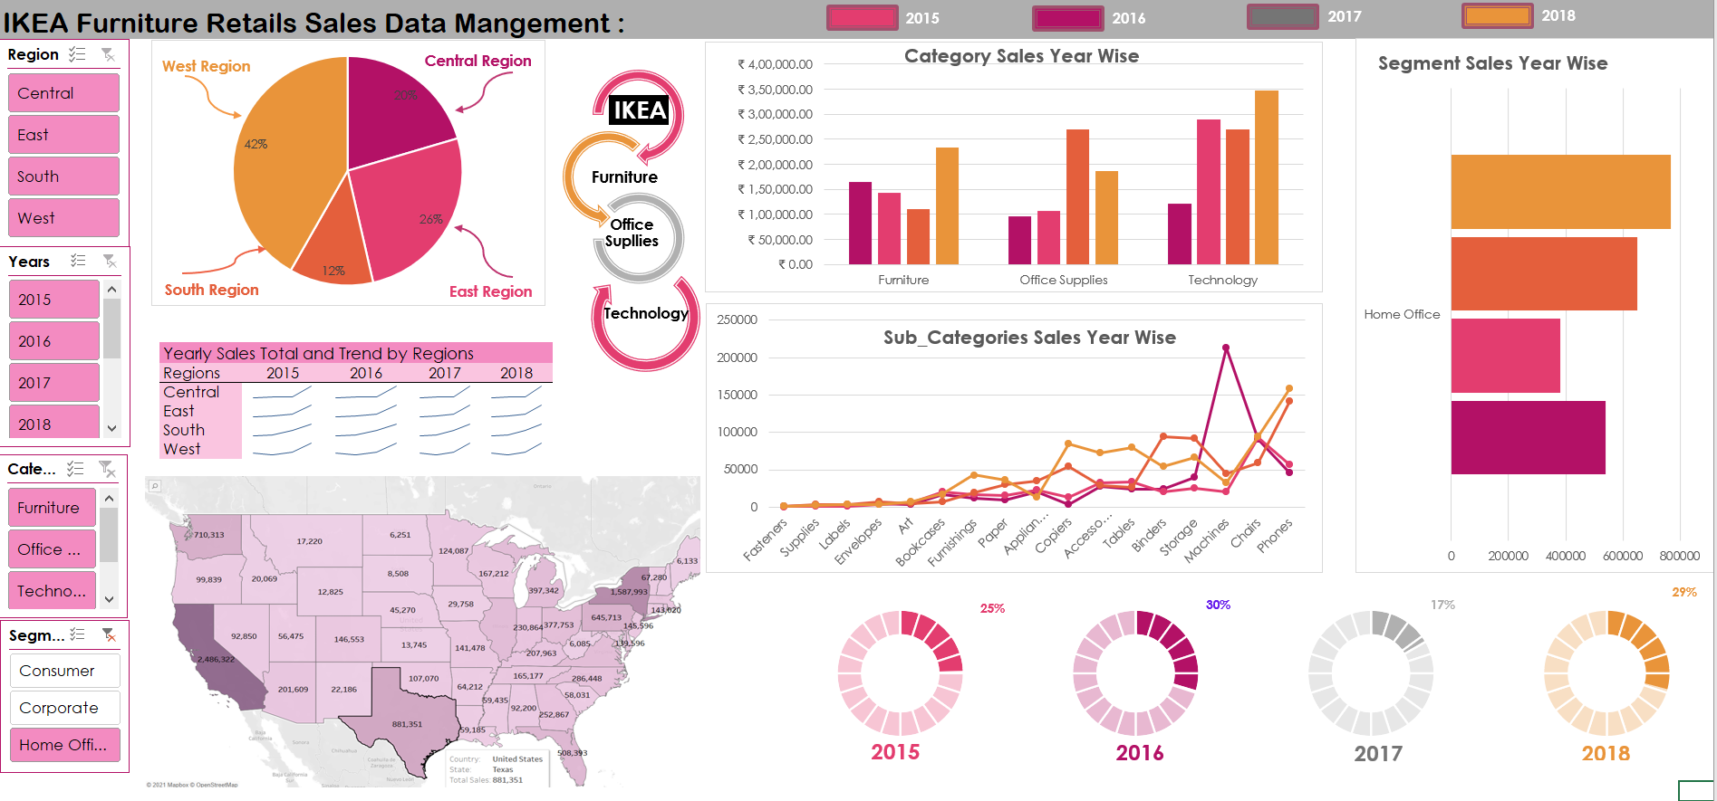
Dashboard :
Analyzing and Extensively research Data Market of IKEA Company, presented in form of Dashboard

Slide 22
Conclusion :
IKEA being a Multinational Furniture Company, it’s mostly downside were Old & Preserved used in Present Markets. The Presence and Understanding of Data Management Team made them to a Market Leading Furniture Sales Company.
Advantages :
Analyzed each Sub-Category market needs, made available region wise
Understood the Nature of trends by Critically thinking about product
Extensively increased the market need by supply the most Required products
By Taking Business to online, Footprints on sales doubled
Created ease in Payment by accepting various payments options
Optimized the Delivery Choices
Though there will be some downside but it’s overshadowed by the available advantages.

Slide 23
Questions?
Thank You

